Slide 1
CS3391 Object Oriented Programming
Dr.D.Sivaganesan, Professor,
PSGiTech / CSE

Slide 2
STATIC MEMBERS
Static is a non-access modifier in Java which is applicable for the following:
blocks
variables
methods
Static blocks
If you need to do computation in order to initialize your static variables, you can declare a static block that gets executed exactly once, when the class is first loaded.
Static variables
When a variable is declared as static, then a single copy of variable is created and shared among all objects at class level. Static variables are, essentially, global variables. All instances of the class share the same static variable.
Important points for static variables
We can create static variables at class-level only.
static block and static variables are executed in order they are present in
a program.

Slide 3
//Java program to demonstrate use of static blocks and variables
class exstaticblock
{
// static variable
static int a = 10; int b;
//static block
static
{
System.out.println("Static block initialized."); b = a * 4;
}
public static void main(String[] args)
{
System.out.println("from main");
System.out.println("Value of a : "+a);
System.out.println("Value of b : "+b);
}
}

Slide 4
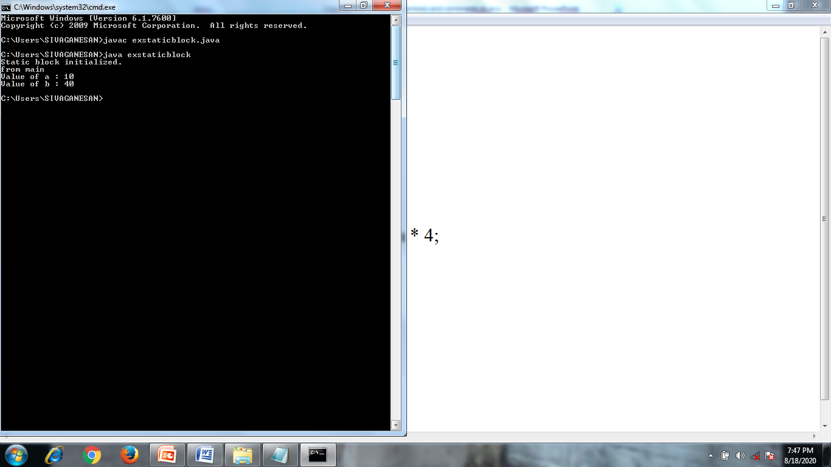

Slide 5
Static methods
When a method is declared with static keyword, it is known as static
method.
When a member is declared static, it can be accessed before any
objects of its class are created, and without reference to any object.
The most common example of a static method is main( ) method.
Methods declared as static have several restrictions:
They can only directly call other static methods.
They can only directly access static data.
They cannot refer to this or super in any way.
Syntax for accessing static var and methods
classname.static method name ( )
classname.static variable name ( )

Slide 6
/*Inside main( ), the static method callme( ) and the static variable b are accessed through their class name Staticmethod*/
class staticmethod
{
static int a = 42;
static int b = 99;
static void callme()
{
System.out.println("a = " + a);
}
}
class exstatmethod {
public static void main(String args[]) {
staticmethod.callme(); // calling static method using class
System.out.println("b = " + staticmethod.b); // accessing static var
}
}

Slide 7
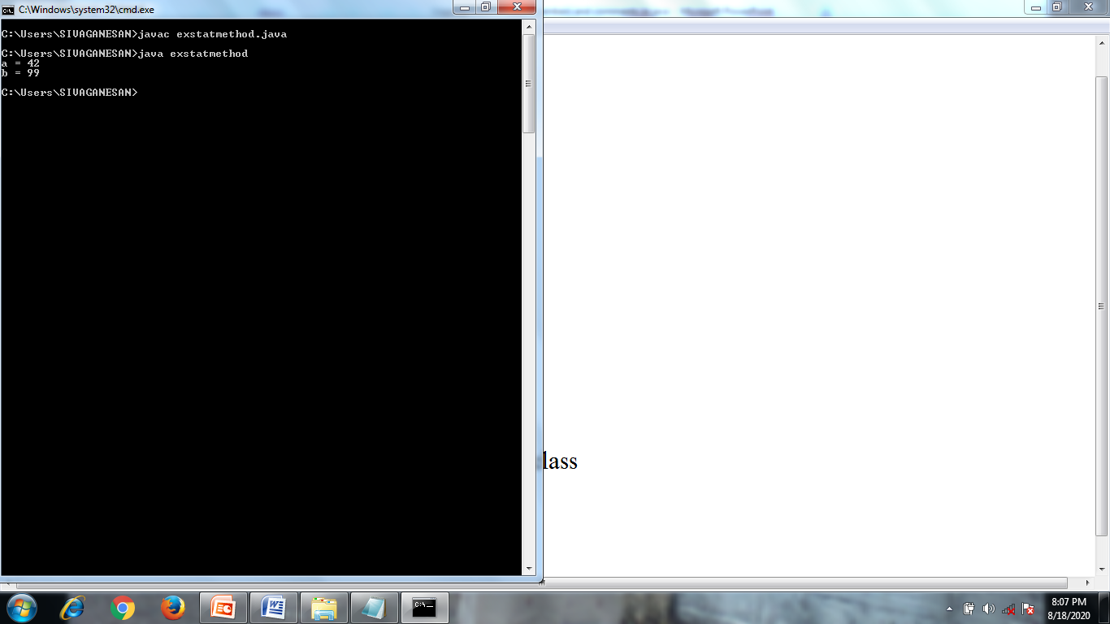

Slide 8
Java Comments
The java comments are statements that are not executed by the
compiler and interpreter.
The comments can be used to provide information or explanation
about the variable, method, class or any statement.
It can also be used to hide program code for specific time.
There are 3 types of comments in java.
1.Single Line Comment
starts with //
2.Multi Line Comment
starts with /* ……………..and end with ……..*/

Slide 9
3.Documentation Comment
starts with /* * ……………..and end with ……..*/
Used to create to create documentation API. To create documentation API, you need to use javadoc tool. This type of comment is used to produce an HTML file that documents your program.
/** The Calculator class provides methods to get addition and subtraction of given 2 numbers.*/
public class Calculator
{
/** The add() method returns addition of given numbers.*/
public static int add(int a, int b)
{
return a+b;
}
/** The sub() method returns subtraction of given numbers.*/
public static int sub(int a, int b)
{
return a-b; } }

Slide 10
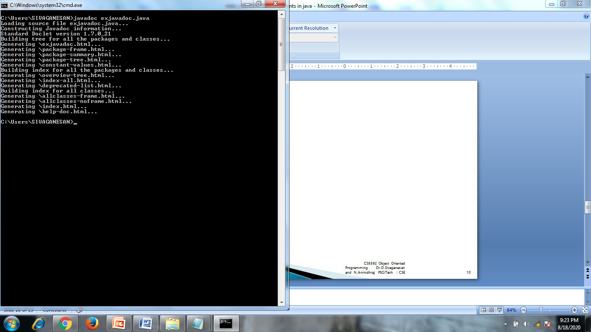

Slide 11
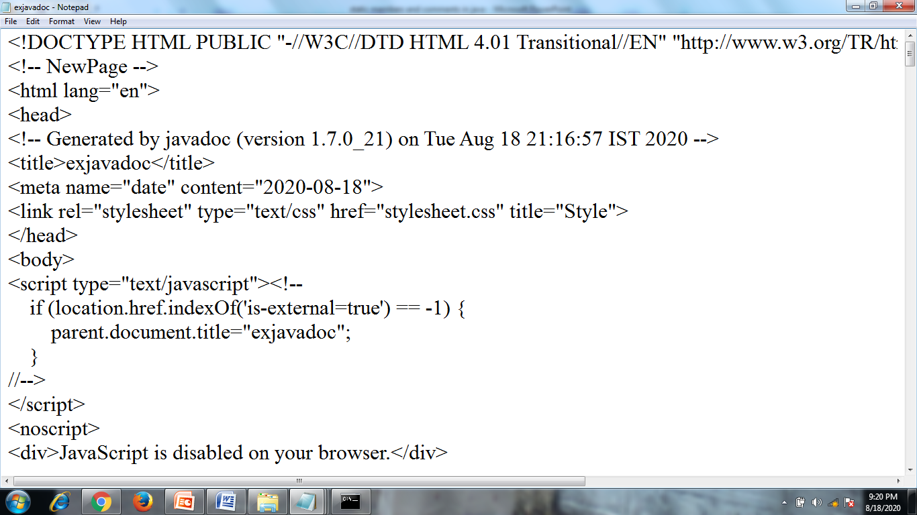

Slide 12
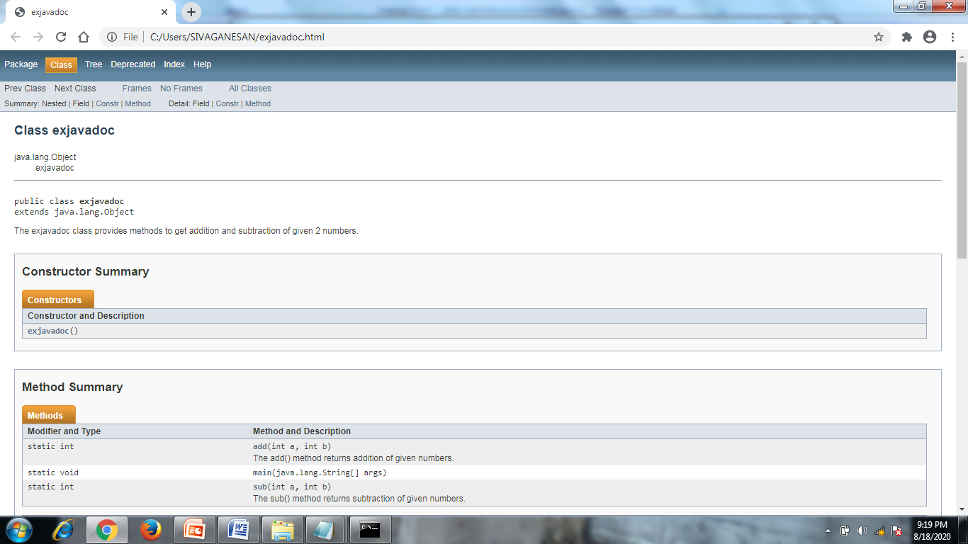

Slide 13
Thank you

